Slide 1
INTRODUCING
Protection
that Starts
On your watch

Slide 2
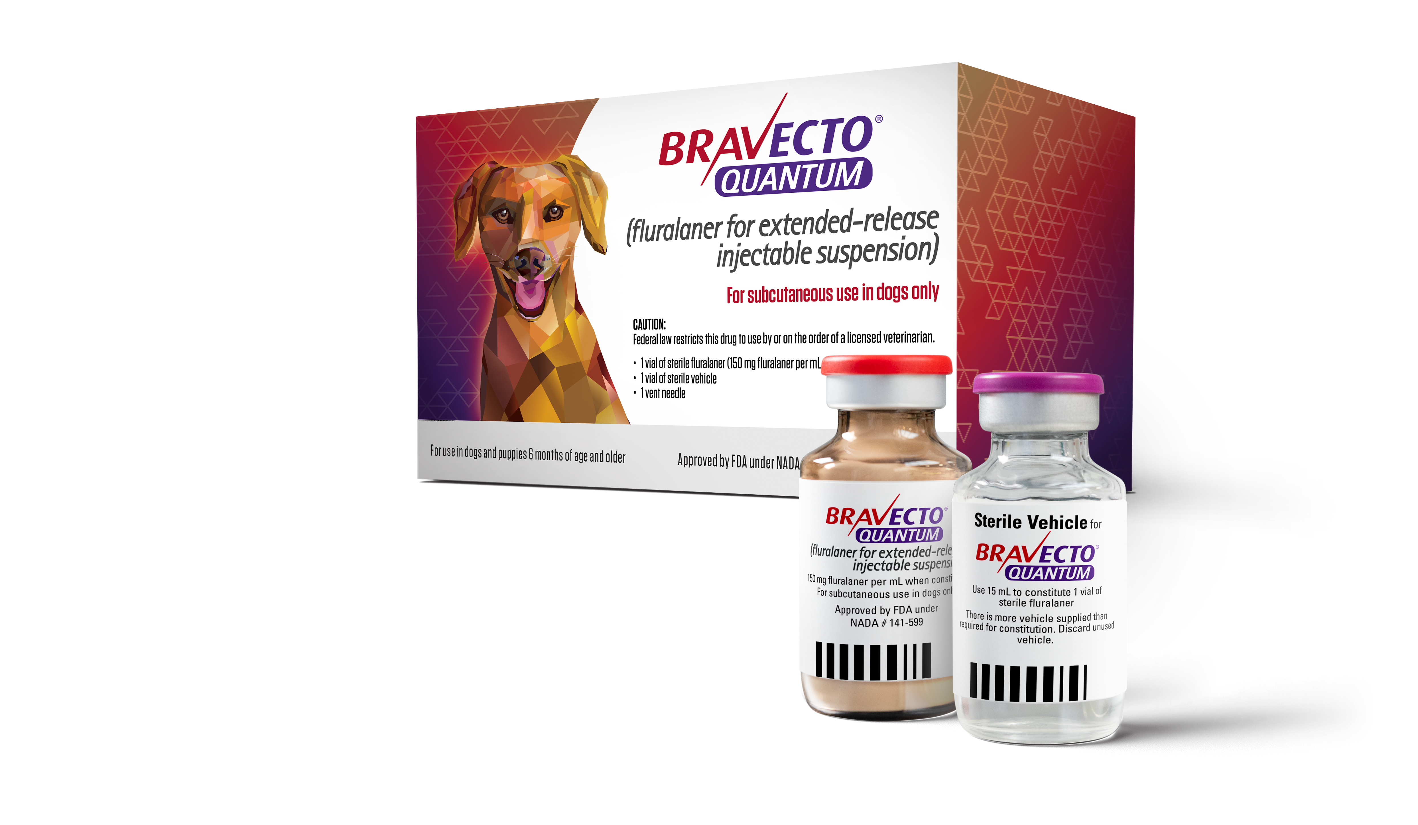
Introducing
BRAVECTO QUANTUM
A breakthrough once-a-year injection that gives veterinarians the power to deliver uninterrupted flea and tick protection
  Up to 12 months* of flea and tick protection
  with just 1 injection¹
TAKE CONTROL
WITH COVERAGE THAT’S ONLY ADMINISTERED
BY VETERINARY PROFESSIONALS LIKE YOU
*
BRAVECTO QUANTUM kills adult fleas, prevents flea infestations, and treats and controls ticks (black-legged, American dog tick, and brown dog tick) for 12 months. BRAVECTO QUANTUM also kills lone star ticks for 8 months.
Reference: 1. BRAVECTO QUANTUM. Product label. Merck Animal Health; 2025.

Slide 3
Improve protection through improved compliance

Slide 4



UNMATCHED PROTECTION
The first and only
once-a-year* injection for
flea and tick protection
A new patented
composition of a trusted active ingredient—fluralaner
12 months* of protection administered only by you
*
BRAVECTO QUANTUM kills adult fleas, prevents flea infestations, and treats and controls ticks (black-legged, American dog tick, and brown dog tick) for 12 months. BRAVECTO QUANTUM also kills lone star ticks for 8 months.

Slide 5
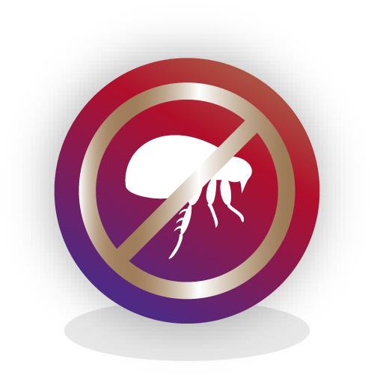

KEY INDICATIONS
Kills adult fleas, and treats and controls tick infestations, for dogs and puppies 6 months of age and older.
Ctenocephalides felis
(cat flea)​
for 12 months
Ixodes
scapularis
(black-legged tick)​
for 12 months
Rhipicephalus sanguineus
(brown dog tick)​
for 12 months
Dermacentor variabilis
(American dog tick)​
for 12 months
Amblyomma americanum
(lone star tick)
for 8 months​

Slide 6
EFFICACY AGAINST FLEAS & TICKS

Slide 7
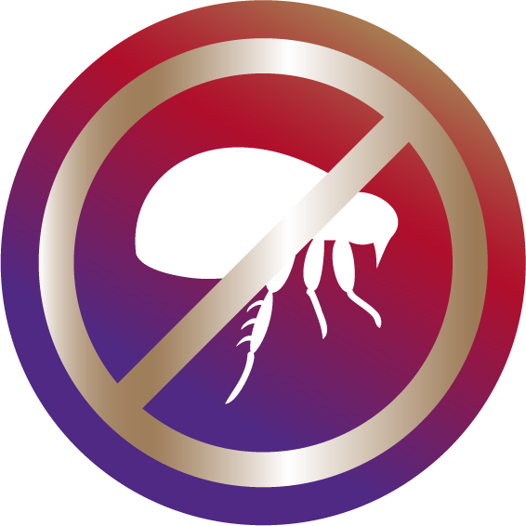
US FIELD STUDY – FLEA Protection¹
Group 1:
BRAVECTO QUANTUM
on Days 0 and 365
Group 2:
BRAVECTO QUANTUM
on Days 0, 180 and 365
Group 3:
BRAVECTO Chews
every 12 weeks
Group 1 – 225 dogs
Group 2 – 51 dogs
Group 3 – 96 dogs
Reference: 1. Freedom of Information Summary, NADA 141-599.

Slide 8

US FIELD STUDY – FLEA protection¹
Dogs treated with
BRAVECTO QUANTUM showed improvement in all flea allergy dermatitis (FAD) signs by
30 days
Majority of
dogs had resolution
of FAD by
84 days
Reference: 1. Freedom of Information Summary, NADA 141-599.

Slide 9

US FIELD STUDY – TICK Protection¹
0 dogs
treated with BRAVECTO QUANTUM
were found to have engorged ticks
at any point after treatment
Reference: 1. Freedom of Information Summary, NADA 141-599.

Slide 10
PROVEN SAFETY IN MULTIPLE STUDIES

Slide 11
FIELD SAFETY TRIAL DATA
US SAFETY TRIAL¹
EUROPEAN SAFETY TRIAL²
Study design
  Randomized, controlled, blinded, multicenter
Sample size
  276 BRAVECTO QUANTUM-treated dogs
Study design
  Randomized, controlled, blinded, multicenter
Sample size
  653 BRAVECTO QUANTUM-treated dogs
No adverse events related to concomitant treatments
References: 1. Freedom of Information Summary, NADA 141-599. 2. Peterson I, Goebel-Lauth S, Pobel T, et al. Clinical efficacy and safety of a single administration of fluralaner injectable suspension (BRAVECTO® injectable) vs. monthly administration of oral afoxolaner (NexGard®) in dogs for tick and flea control over one year under European field conditions. Parasit Vectors. 2024;17:504. doi:10.1186/s13071-024-06590-1
Notes:
Studies report the safe use of Bravecto Quantum when used according to label directions. (Freedom of Information Summary, NADA 141-599)

Slide 12
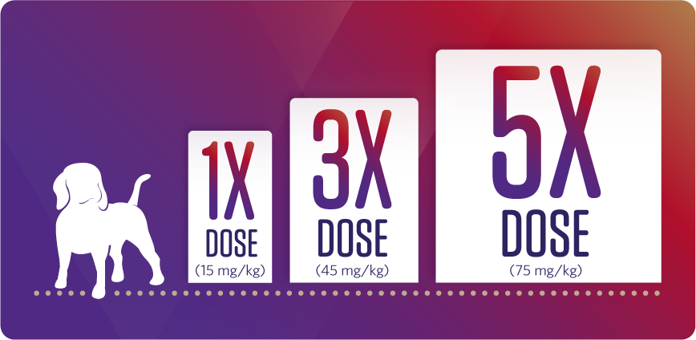
MARGIN OF SAFETY STUDY – DESIGN
Patients given 1X, 3X, and 5X recommended dose every 4 months
for 6 doses over 20 months¹
Reference: 1. Freedom of Information Summary, NADA 141-599.
Notes:
Studies report the safe use of Bravecto Quantum when used according to label directions. (Freedom of Information Summary, NADA 141-599)

Slide 13



DESIGNED WITH YOUR CLINIC IN MIND
BRAVECTO QUANTUM is easy to incorporate into your practice
MORE CONTROL
MORE BUSINESS BENEFITS
MORE CONVENIENCE AND CONFIDENCE
Deliver 12 months*
of uninterrupted flea
and tick protection.¹
Strengthen client
relationships and take control of compliance
and revenue.
1 simple injection
gives clients 1 less thing
to worry about.
*
BRAVECTO QUANTUM kills adult fleas, prevents flea infestations, and treats and controls ticks (black-legged, American dog tick, and brown dog tick) for 12 months. BRAVECTO QUANTUM also kills lone star ticks for 8 months.
Reference: 1. BRAVECTO QUANTUM. Product label. Merck Animal Health; 2025.

Slide 14
ADMINISTRATION
GUIDE TO BODY WEIGHT-SPECIFIC DOSE VOLUMES
BODY WEIGHT (LB) | BODY WEIGHT (KG) | DOSE VOLUME (ML)
2.2 lb | 1 kg | 0.1 mL
11 lb | 5 kg | 0.5 mL
22 lb | 10 kg | 1.0 mL
33 lb | 15 kg | 1.5 mL
44 lb | 20 kg | 2.0 mL
55 lb | 25 kg | 2.5 mL
66 lb | 30 kg | 3.0 mL
77 lb | 35 kg | 3.5 mL
88 lb | 40 kg | 4.0 mL
99 lb | 45 kg | 4.5 mL
110 lb | 50 kg | 5.0 mL
121 lb | 55 kg | 5.5 mL
132 lb | 60 kg | 6.0 mL
  For use in dogs and puppies 6 months of age and older
  For subcutaneous injection only
  Dose of suspended product:
  0.1 mL/kg (0.045 mL/lb)
  The dog should be weighed at the time of dosing
  to ensure an accurate dose
  Administer between the shoulder blades
  (interscapular region)
Administer the dose within 2 minutes of drawing into the dosing syringe.
Always use an 18 G needle! Smaller needles will block the transfer of particles.

Slide 15

DESIGNED
FOR STABILITY AND EFFICIENCY
  EXTENDED SHELF LIFE
  Remains stable for up to 3 YEARS in original packaging
  Stays potent for A FULL 3 MONTHS after mixing
  CONVENIENT STORAGE
  No refrigeration needed
  EFFICIENT DOSING
  Each vial treats approximately 7 patients*
* Varies by weight of dog.

Slide 16
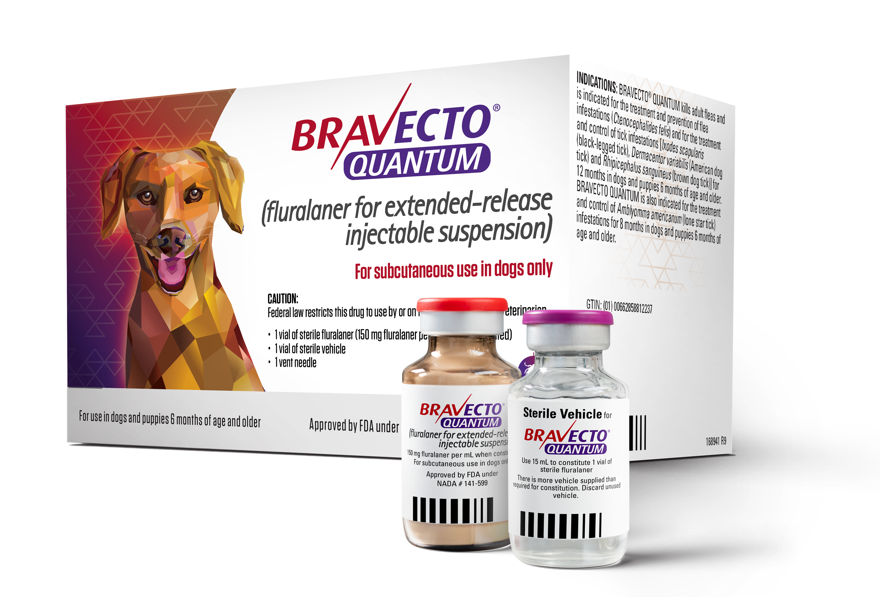
1 INJECTION. 1 YEAR* OF PROTECTION.
  Discover a new, innovative formulation of a trusted active ingredient.
  The first and only once-a-year* injection for flea
  and tick protection
  A new patented composition of a trusted active ingredient—fluralaner
  Easy administration by you in your practice
  12 months* of efficacy against fleas and ticks
  Get peace of mind with the BRAVECTO Promise
ORDER BRAVECTO QUANTUM AND DELIVER YEAR-ROUND* PROTECTION WITH 1 INJECTION.​
*
BRAVECTO QUANTUM kills adult fleas, prevents flea infestations, and treats and controls ticks (black-legged, American dog tick, and brown dog tick) for 12 months. BRAVECTO QUANTUM also kills lone star ticks for 8 months.

Slide 17
IMPORTANT SAFETY INFORMATION
BRAVECTO QUANTUM (fluralaner for extended-release injectable suspension) for Dogs: The most commonly reported adverse reactions in a US field study included lethargy, decreased appetite, vomiting, diarrhea, elevated liver enzymes and pruritus. BRAVECTO QUANTUM is not effective against lone star ticks beyond 8 months of dosing. Fluralaner is a member of the isoxazoline class. This class has been associated with neurologic adverse reactions including tremors, ataxia, and seizures. Seizures have been reported in dogs receiving isoxazoline class drugs, even in dogs without a history of seizures. Use with caution in dogs with a history of seizures or neurologic disorders. The safety of BRAVECTO QUANTUM has not been evaluated in breeding, pregnant and lactating dogs. In some cases, adverse events have been reported following use of BRAVECTO (fluralaner) Chews in breeding females. For use in dogs and puppies 6 months of age and older. For complete safety information, refer to the product label.

Slide 18
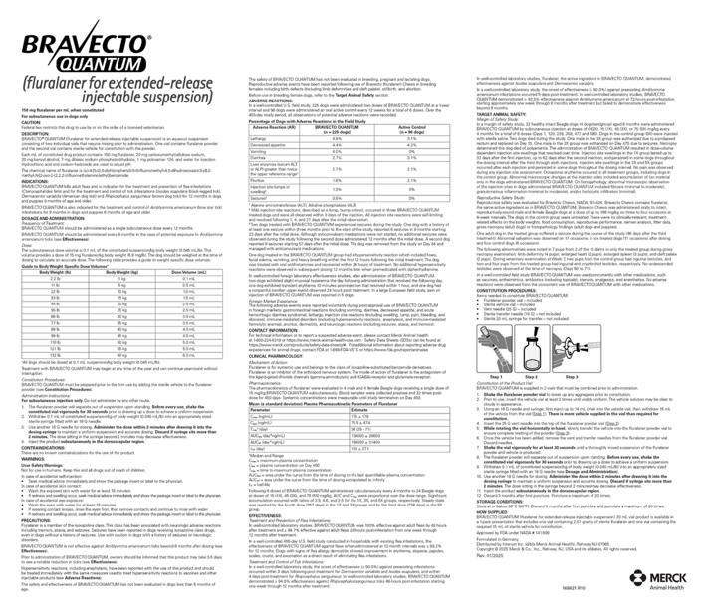
Product label

