Slide 1

THE NOBIVAC® NXT LEVEL OF INNOVATION
The first and only line of companion animal vaccines built on RNA particle technology

Slide 2

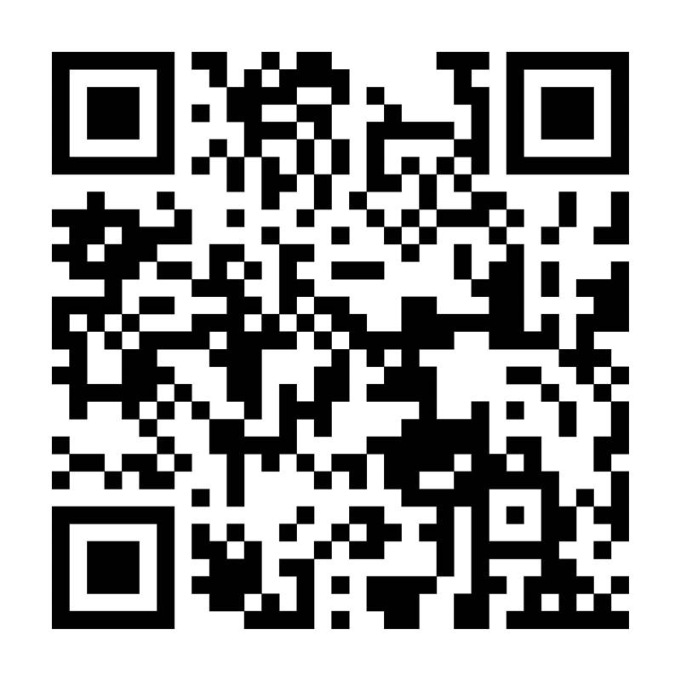

Nobivac® NXT Videos
How it works
Features and benefits

Slide 3
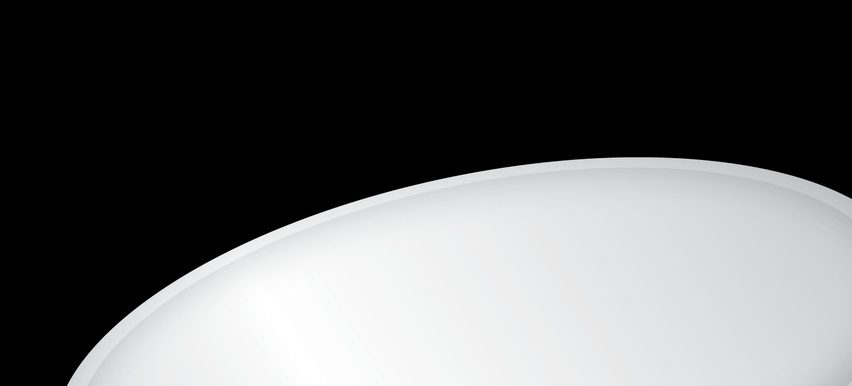
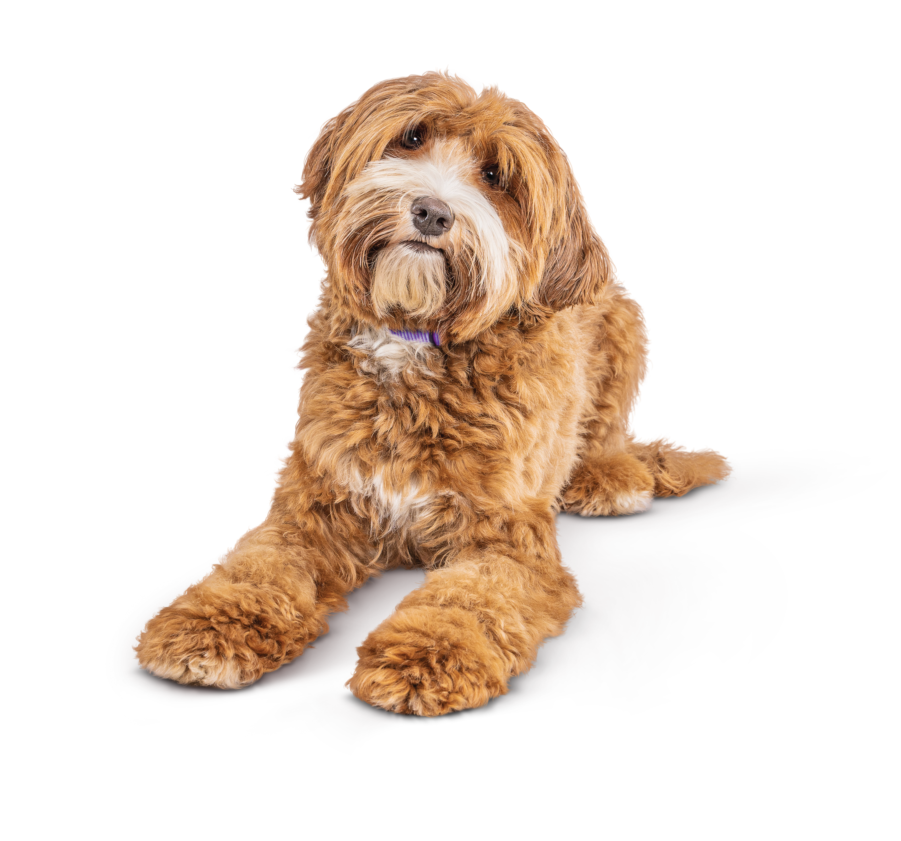
DELIVER
NOBIVAC® NXT-LEVEL IMMUNITY
Protect against canine influenza (CIV) in a non-adjuvanted, low-volume vaccine
Notes:
Introducing the first and only canine flu vaccine built on RNA particle technology: Nobivac® NXT Canine Flu H3N2, a non-adjuvanted, low-volume vaccine that delivers exceptional protection against canine influenza virus (CIV).

Slide 4
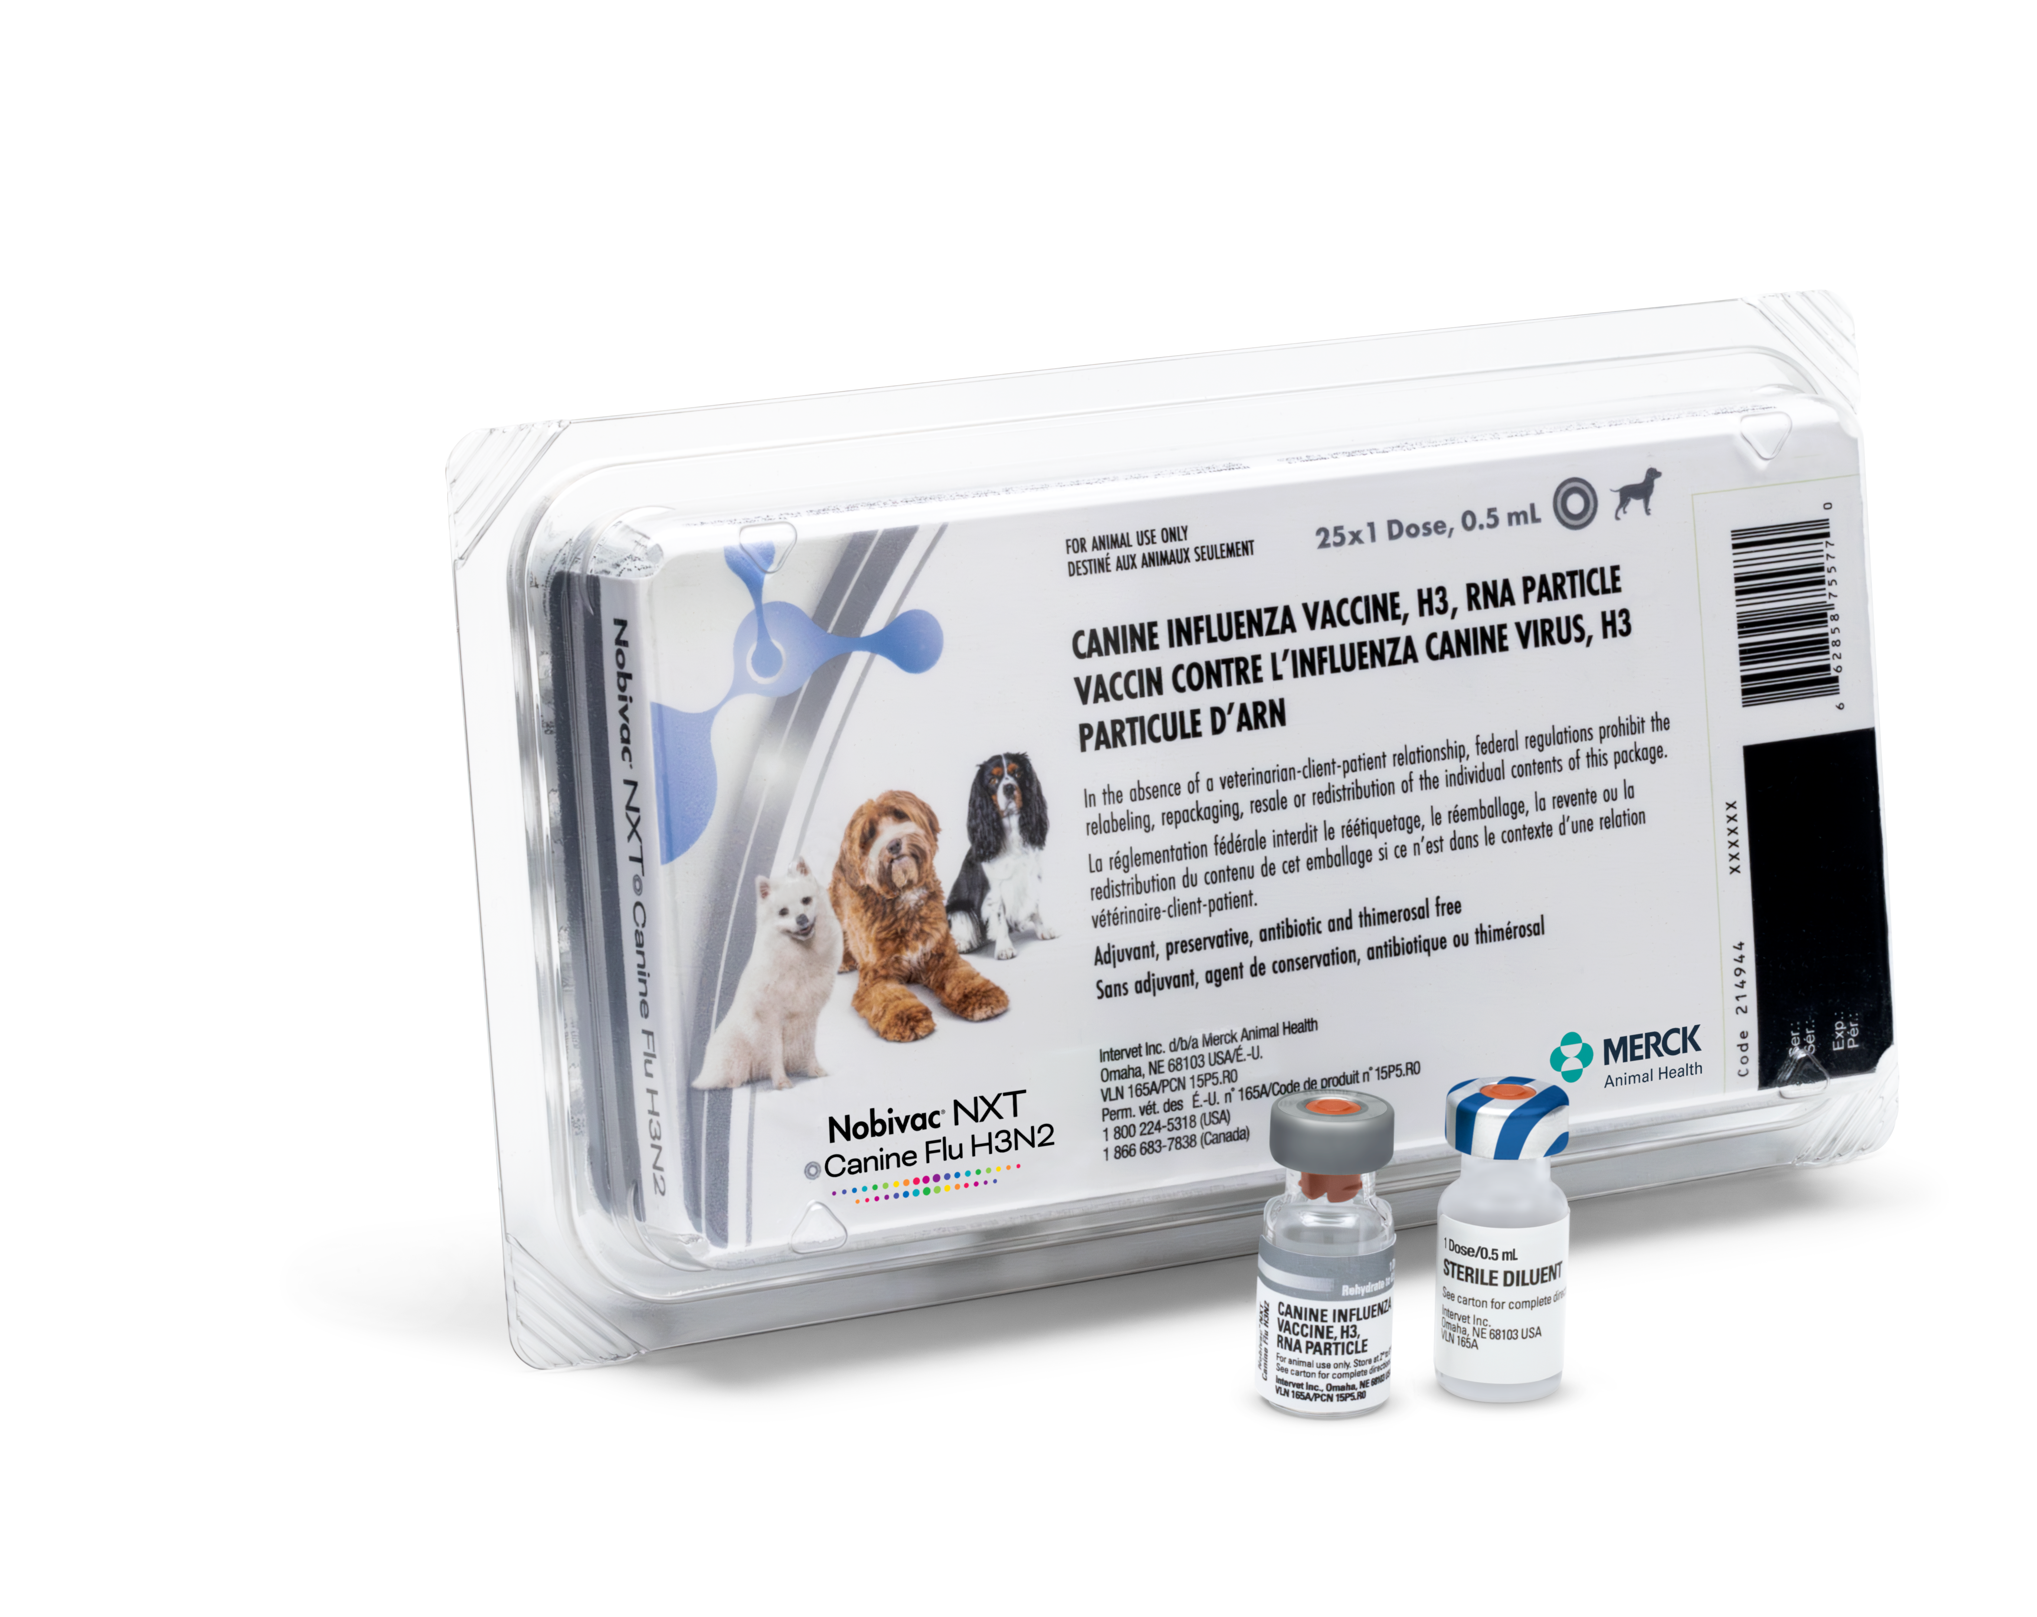
Nobivac® NXT Canine Flu H3N2

Slide 5
Dosing
A low-volume 0.5-mL dose provides
a more gentle vaccine experience
8 weeks minimum age
3-4 weeks initial booster series
Duration of immunity has not been established
Recommended yearly boosters*
Store at 2-8 ºC (35-46 ºF)
Needs to be reconstituted
*DOI has not been evaluated
Notes:
Nobivac® NXT Canine Flu H3N2 is a 0.5-mL dose vaccine. It may be given to puppies as young as 8 weeks of age with an initial primary immunization series of 2 doses administered 3-4 weeks apart. ​ Duration of immunity has not been established for this vaccine or other CIV vaccines. As with the other CIV vaccines, annual vaccination with 1 dose is recommended.
This vaccine does not require special storage but does need to be reconstituted.

Slide 6
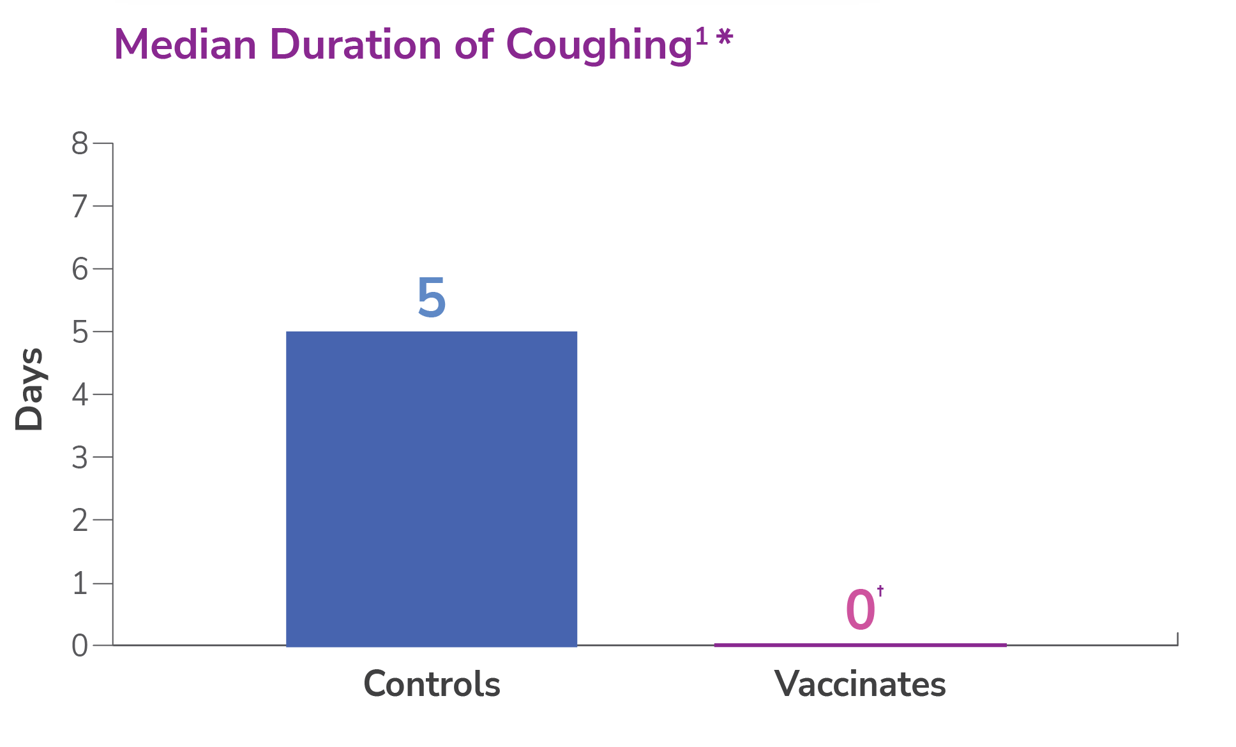
Significantly reduces coughing
* P<0.0001
*
Reference: 1. Data on file. Merck Animal Health.
Notes:
What does that mean for our pets? This next-level immunity translates into protection that significantly reduces the median duration of coughing for dogs exposed to canine influenza.
A challenge study involving 8-week-old puppies showed that Nobivac® NXT Canine Flu H3N2 significantly reduces coughing (P<0.0001). Two doses of Nobivac® NXT Canine Flu H3N2 at a commercial field dose were administered subcutaneously, 3 weeks apart. Challenge was conducted 2 weeks post 2nd vaccination. Clinical observations were recorded for 10 days post-challenge, and nasal swabs were collected for 10 consecutive days to determine viral shedding. Lungs were evaluated 10 days following challenge.

Slide 7
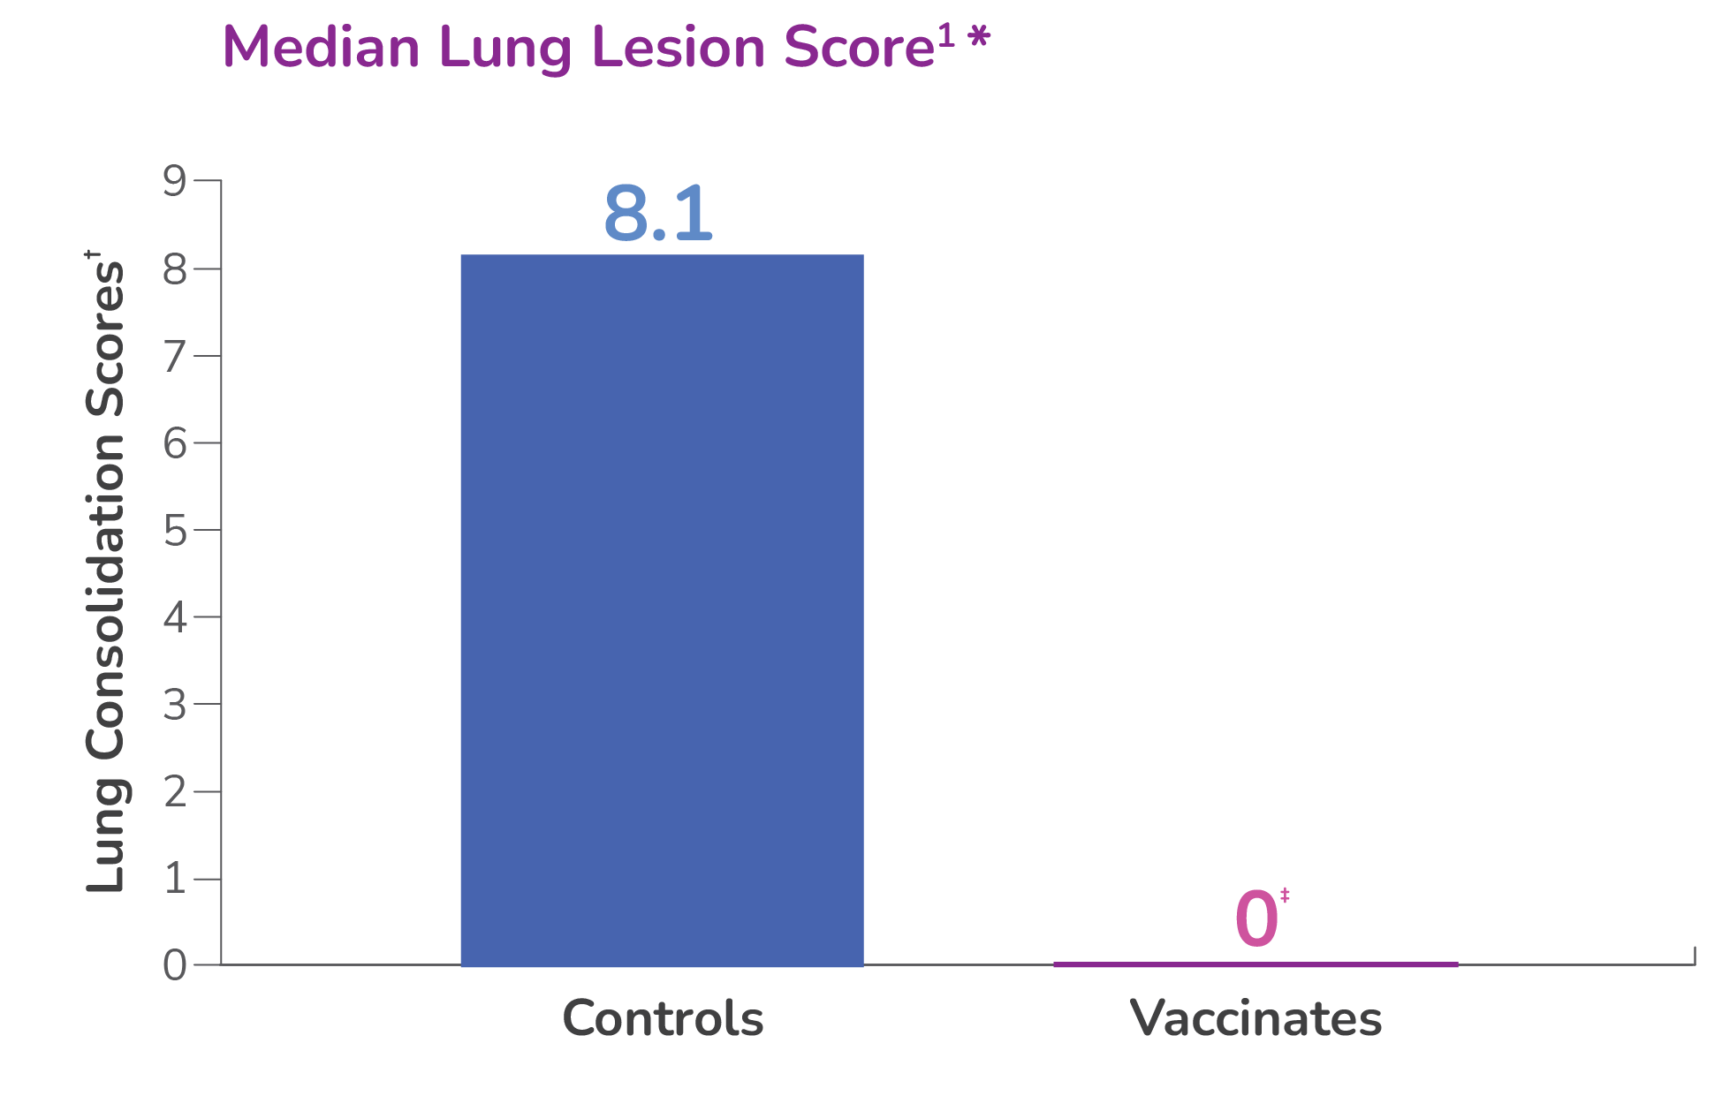
Highly effective in protecting the lungs
* The standardized method of evaluating efficacy of
canine influenza vaccines is based on lung lobe
consolidation.²
† P<0.0001
Reference: 1. Data on file. Merck Animal Health.
2. Deshpande MS, Jirjis FF, Tubbs AL, et al. Evaluation of the efficacy of a canine influenza virus (H3N8) vaccine in dogs following experimental challenge. Vet Therapeut. 2009;10(3):103-112.
†
Notes:
Nobivac® NXT-level immunity also protects dogs’ lungs from the damage that canine influenza can cause.
A challenge study involving 8-week-old puppies showed that Nobivac® NXT Canine Flu H3N2 significantly reduces lung lesion scores (P<0.0001). Two doses of Nobivac® NXT Canine Flu H3N2 at a commercial field dose were administered subcutaneously, 3 weeks apart. Challenge was conducted 2 weeks post 2nd vaccination. Clinical observations were recorded for 10 days post-challenge, and nasal swabs were collected for 10 consecutive days to determine viral shedding. Lungs were evaluated 10 days following challenge.

Slide 8
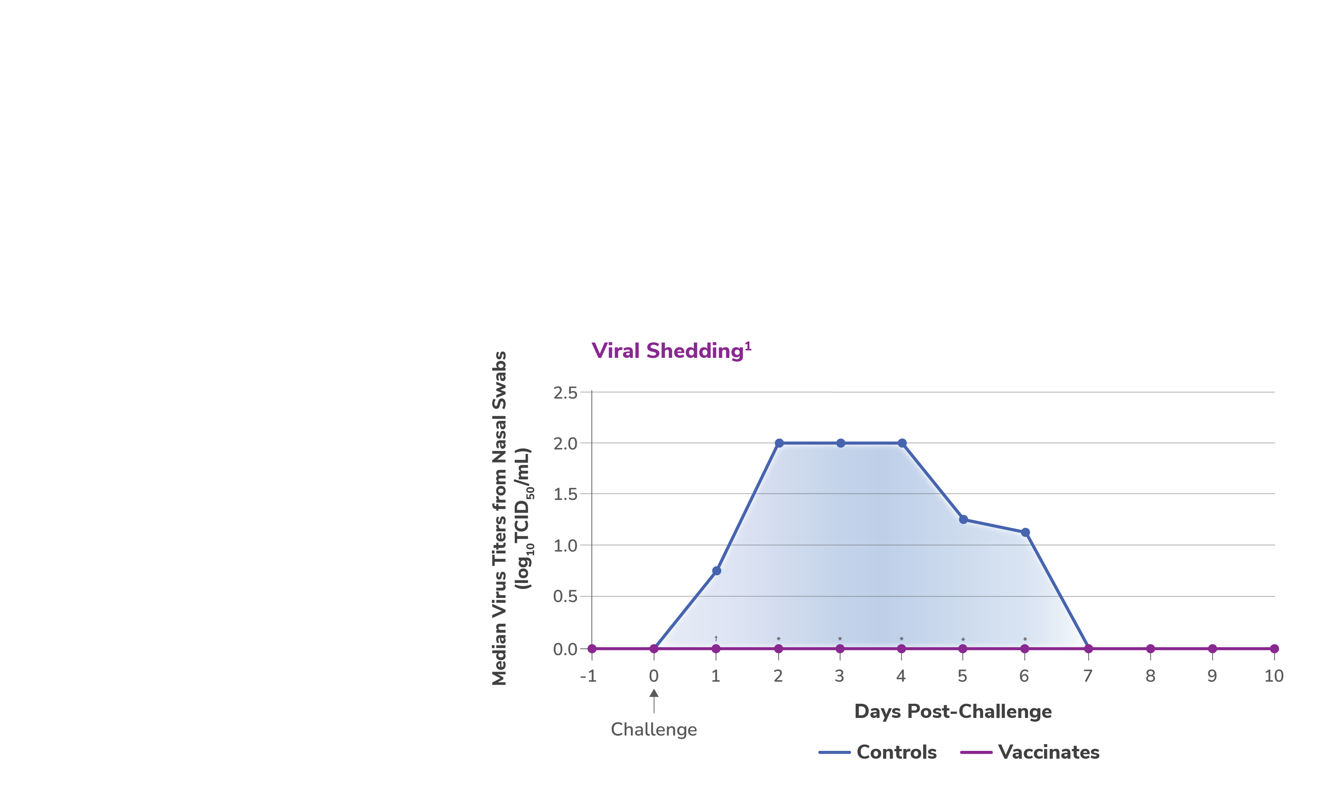

Duration and amount of viral shedding significantly reduced *†
Decreased shedding reduces the opportunity for CIV to infect other dogs.
* Overall duration of viral shedding and magnitude
of viral shedding – P<0.0001
† Magnitude of viral shedding on Day 1 – P=0.0001
Reference: 1. Data on file. Merck Animal Health.
Notes:
Nobivac® NXT Canine Flu H3N2 also significantly reduced the duration of viral shedding. In addition, as shown here, the median amount of shedding from the
vaccinates was significantly reduced compared to the control dogs.
Decreased shedding reduces the opportunity for CIV to infect other dogs, which can be crucial in helping to prevent or slow an outbreak.
[NOTES]
A vaccination-challenge study included 40, 8-week-old puppies. Two doses of Nobivac® NXT Canine Flu H3N2 at a commercial field dose were administered subcutaneously, 3 weeks apart. Challenge was conducted 2 weeks post 2nd vaccination. Clinical observations were recorded for 10 days post-challenge, and nasal swabs were collected for 10 consecutive days to determine viral shedding. Lungs were evaluated 10 days following challenge.
The duration of shedding was significantly different between the vaccinates and the controls with a P value of <0.0001. The magnitude of shedding, as measured from
nasal swabs, was significantly different with a P value = 0.0001 on Day 1 and <0.0001 on Days 2 - 6.

Slide 9
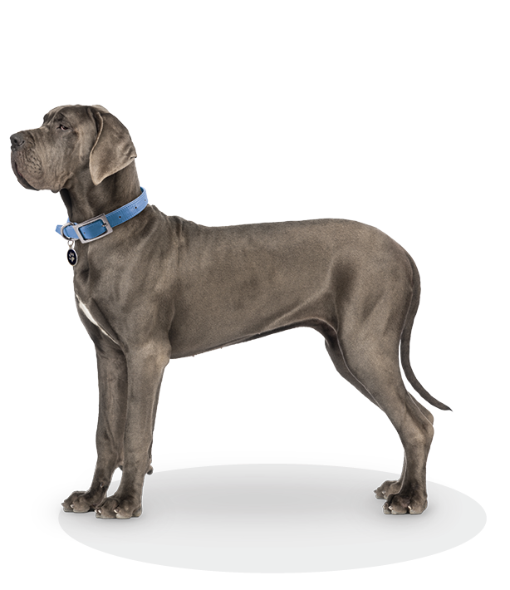
Demonstrated safety under field conditions
Proven safe across a variety of breeds and ages in a field safety study¹
1,301 doses administered to 654 dogs of
various breeds
Dogs ranged in age from 8 weeks to 15 years
Lethargy was the most common adverse
event (1.6%)
Reference: 1. Data on file. Merck Animal Health.
Notes:
Nobivac® NXT Canine Flu H3N2 also demonstrated exceptional safety under field conditions, proven safe across a variety of breeds and ages.¹ 1,301 doses were administered to 654 dogs of various breeds, ranging from 8 weeks to 15 years old. The most common adverse event was lethargy, observed in only 1.6% of doses.
[NOTES]
Reference: 1. Data on file. Merck Animal Health.

Slide 10
Why protect against H3N2?
Laboratory surveillance indicates CIV H3N2 as the critical strain of concern.¹
The CIV H3N8 virus is no longer active in the US and appears to be extinct.²
Reference: 1. IDEXX Laboratories – Results from samples submitted for CIRD testing in the US.
2. Sykes J. Greene's Infectious Diseases of the Dog and Cat, 5th ed. Elsevier; 2023: 316.
Notes:
Why is it important to protect against H3N2 specifically?
For many years, H3N8 and H3N2 were identified in outbreaks across the US. However, recent laboratory surveillance indicates CIV H3N2 as the critical strain of concern. IDEXX Laboratory testing last identified a case of CIV H3N8 in 2017.
When the most recent canine influenza chapter in Greene’s Infectious Diseases of the Dog and Cat was published in 2023, the authors stated that “the [H3N8] virus appears to be extinct.”

Slide 11
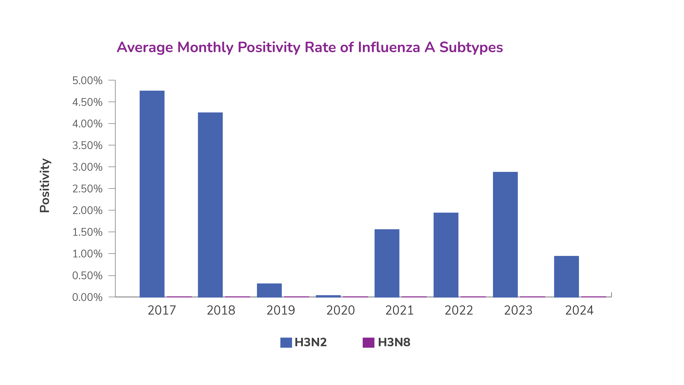
H3N8 has not been detected since 2017¹
Reference: 1. IDEXX Laboratories – Results from samples submitted for CIRD testing in the US
Notes:
IDEXX laboratory testing last identified a case of CIV H3N8 in 2017. H3N2, however, has been found in numerous dogs, year over year.
Between October of 2022 and April of 2024¹:
79,567 samples were submitted to IDEXX for CIRD testing
2206 (3%) were positive for H3N2
Not a single case of H3N8 was detected
References: 1. IDEXX Laboratories – Results from samples submitted for CIRD testing in the US

Slide 12
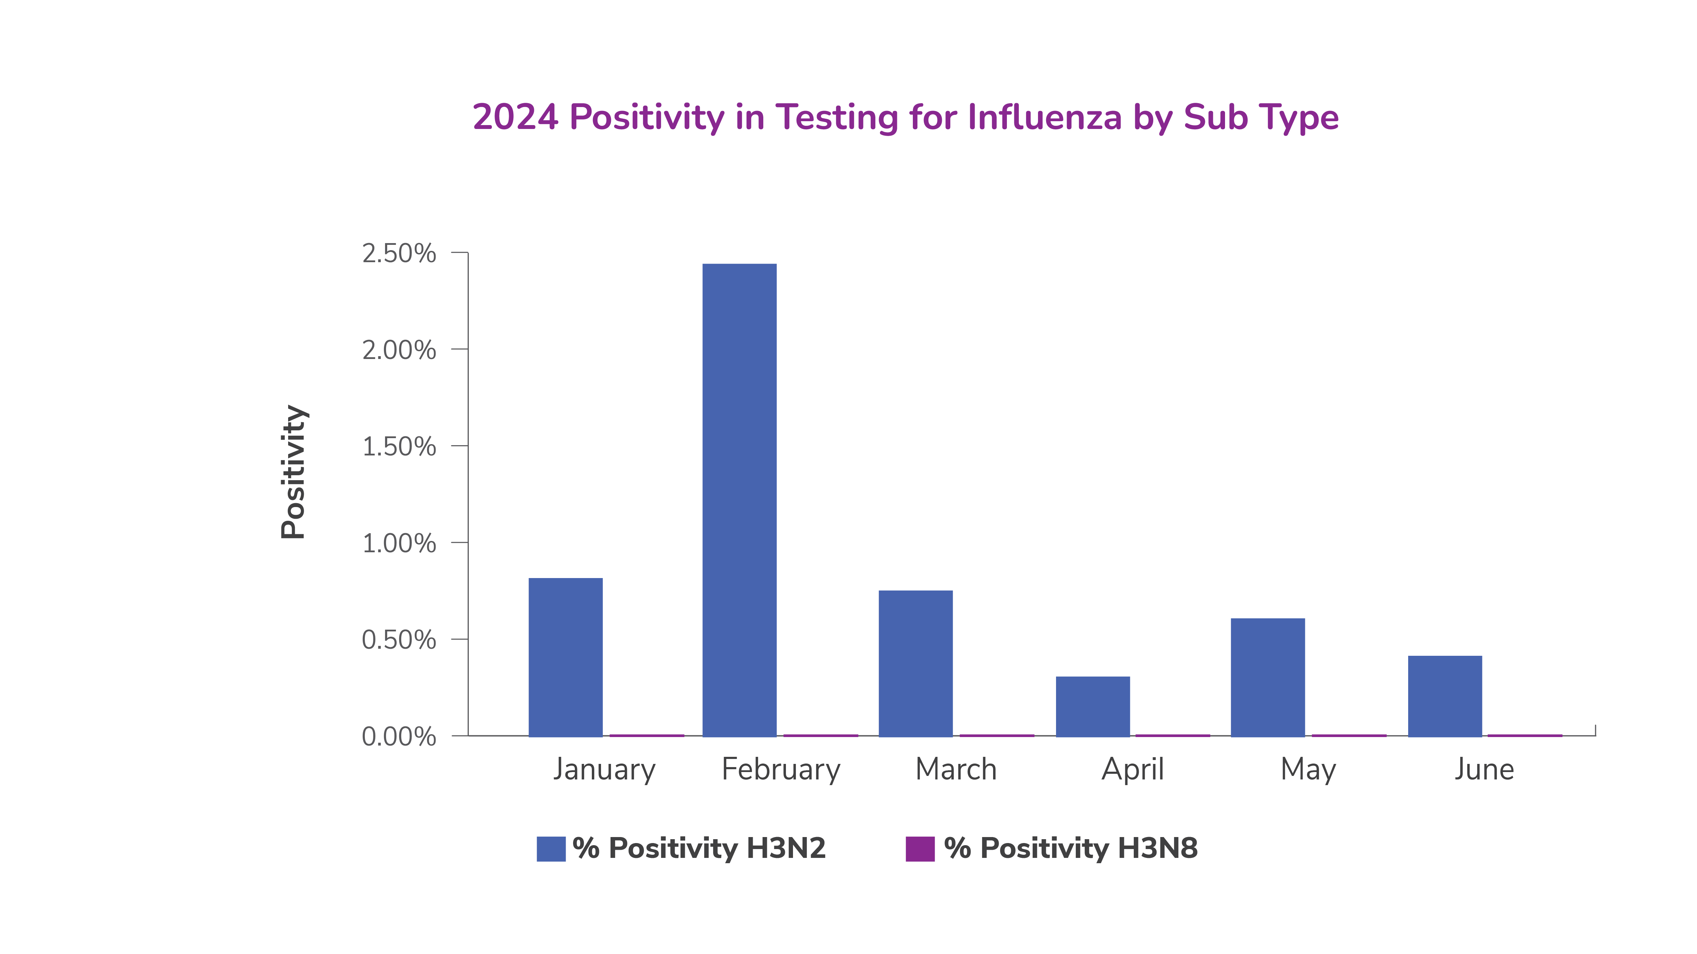
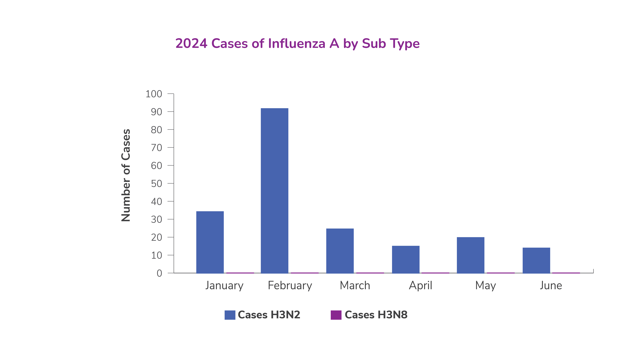
Cases in 2024, H3N2 detected every month
Zero cases of H3N8 detected. H3N2 detected monthly.
Reference: 1. IDEXX Laboratories – Results from samples submitted for CIRD testing in the US
Notes:
So far, 2024 has continued the trend, with H3N2 being detected each month and zero H3N8 cases confirmed. From 2017 to today, we can confidently say that our focus as a veterinary community needs to be on protecting dogs from H3N2 more than any other strain.

Slide 13
Thank You
Questions?
All trademarks are property of their respective owners.

