Slide 1
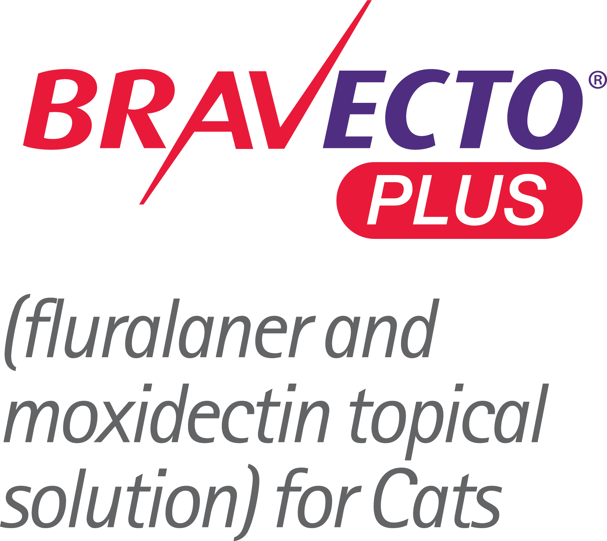



with a
against a growing threat to your feline patients

Slide 2

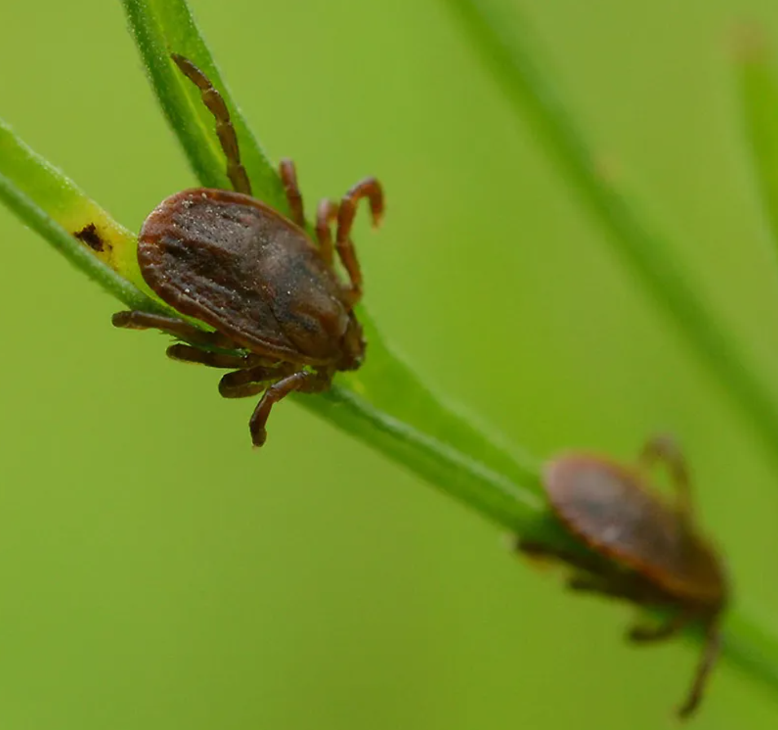


Threats of the Asian Longhorned Tick
(Haemaphysalis longicornis)¹
Invasive
Can reproduce without a male
Aggressive biter
Known serious pest of livestock in endemic areas
Found on a variety of hosts
Adaptable to many habitats and climates
Vector of numerous tick-borne pathogens
Photo courtesy of KIM, Hyun-tae via iNaturalist, CC BY 4.0
Reference: 1. USDA National Haemaphysalis longicornis (Asian longhorned tick) Situation Report, as of August 23, 2022. Accessed September 1, 2022. https://www.aphis.usda.gov/animal_health/animal_diseases/tick/downloads/longhorned-tick-sitrep.pdf
Notes:
The Asian longhorned tick, or Haemaphysalis longicornis, is a relatively new threat in the Western Hemisphere, first reported in the United States in 2017.²
The tick is parthenogenic, meaning females can produce viable eggs without mating with a male tick, so a single female tick can create a new area of infestation.¹ As far as we know, there have been no longhorned tick males in the US, so the ticks in the US are clones of the females.
Native to East Asia, these ticks have been found on 30 different species including people, dogs, cats, white-tailed deer, and other wildlife¹, proving that it is not a picky eater. In native countries, this tick is capable of transmitting viral, bacterial, and protozoal pathogens to various mammals.³
References: 1. USDA National Haemaphysalis longicornis (Asian longhorned tick) Situation Report, as of August 23, 2022. Accessed September 1, 2022. https://www.aphis.usda.gov/animal_health/animal_diseases/tick/downloads/longhorned-tick-sitrep.pdf 2. What you need to know about Asian longhorned ticks – a new tick in the United States. Centers for Disease Control and Prevention website. Last reviewed September 27, 2021. Accessed September 1, 2022. https://www.cdc.gov/ticks/longhorned-tick/index.html 3. Saleh MN, Allen KE, Lineberry MW, Little SE, Reichard MV. Ticks infesting dogs and cats in North America: Biology, geographic distribution, and pathogen transmission. Vet Parasitol. 2021;294:109392.

Slide 3
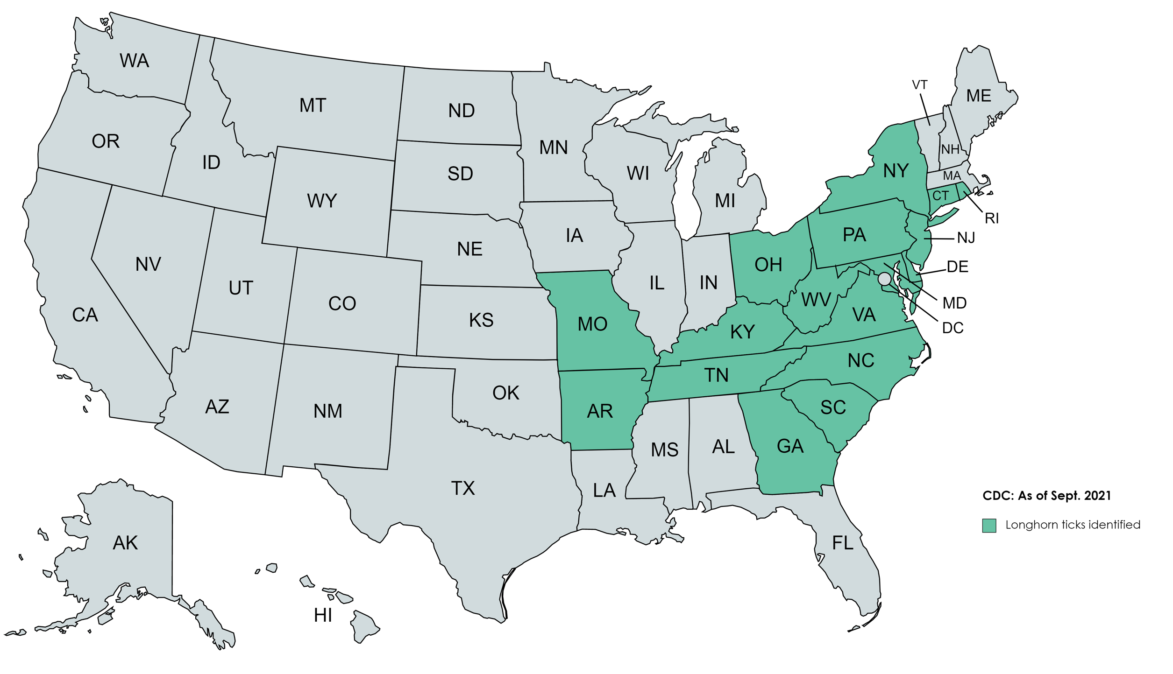
Prevalence of Asian Longhorned Ticks
References: 1. What you need to know about Asian longhorned ticks – a new tick in the United States. Centers for Disease Control and Prevention website. Last reviewed September 27, 2021. Accessed September 1, 2022. https://www.cdc.gov/ticks/longhorned-tick/index.html 2. Saleh MN, Allen KE, Lineberry MW, Little SE, Reichard MV. Ticks infesting dogs and cats in North America: Biology, geographic distribution, and pathogen transmission. Vet Parasitol. 2021;294:109392.
Notes:
This map illustrates where Asian longhorned ticks have been found within the US.
As of June 2022, the longhorned tick has been found in 17 states. However, it is likely that this tick will spread. Some environmental factors expected to fuel the spread include humidity, warm temperatures, and grassy habitats. ² Much of North America is considered a suitable habitat for this tick.
References: 1. What you need to know about Asian longhorned ticks – a new tick in the United States. Centers for Disease Control and Prevention website. Last reviewed September 27, 2021. Accessed September 1, 2022. https://www.cdc.gov/ticks/longhorned-tick/index.html 2. Saleh MN, Allen KE, Lineberry MW, Little SE, Reichard MV. Ticks infesting dogs and cats in North America: Biology, geographic distribution, and pathogen transmission. Vet Parasitol. 2021;294:109392.

Slide 4
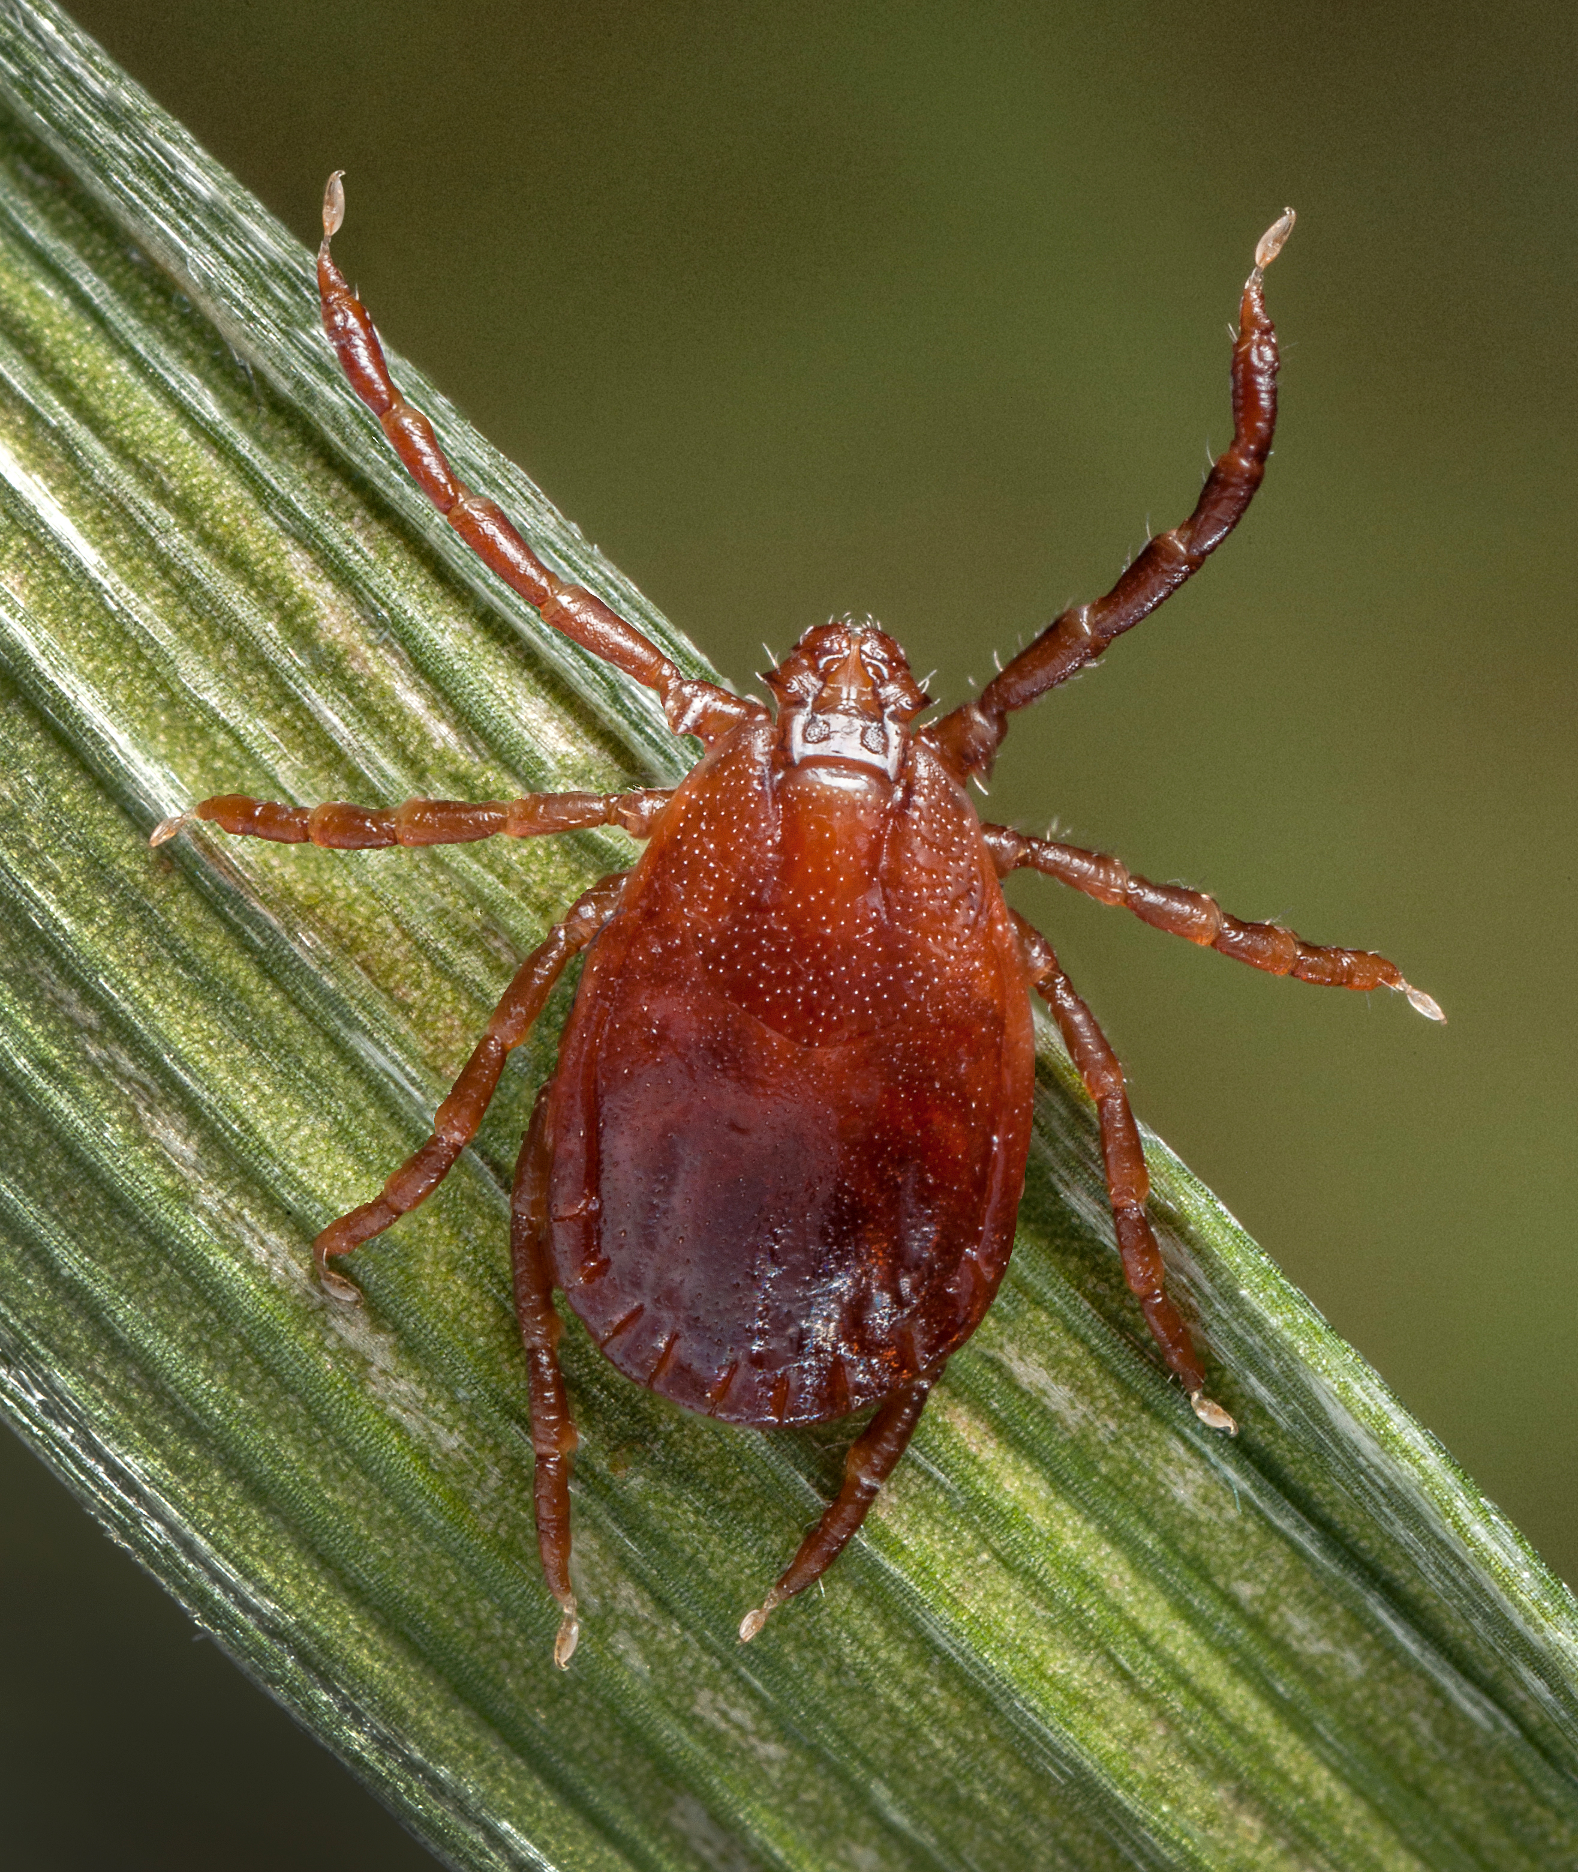
Protection Against the Asian Longhorned Tick (Haemaphysalis longicornis)¹
BRAVECTO® PLUS and BRAVECTO® Topical Solution for Cats are the FIRST AND ONLY products indicated to protect cats from Asian longhorned ticks.^{1,2}
Photo source: James Gathany
Reference: 1. BRAVECTO® PLUS [product label]. Madison, NJ: Merck Animal Health; 2022. 2. BRAVECTO® Topical Solution for Cats [product label]. Madison; NJ: Merck Animal Health; 2022.
Notes:
Only BRAVECTO® PLUS and BRAVECTO® Topical Solution for Cats are indicated to protect cats from Asian longhorned tick infestations.^{1,2}
BRAVECTO® PLUS is indicated to protect cats from the Asian longhorned tick for
2 months, while BRAVECTO® Topical Solution for Cats will provide protection for
12 weeks.
References: 1. BRAVECTO® PLUS [product label]. Madison, NJ: Merck Animal Health; 2022. 2. BRAVECTO® Topical Solution for Cats [product label]. Madison; NJ: Merck Animal Health; 2022.

Slide 5
Important Safety Information
BRAVECTO (fluralaner topical solution) for Cats: The most commonly reported adverse reactions include vomiting, itching, diarrhea, hair loss, decreased appetite, lethargy, and scabs/ulcerated lesions. BRAVECTO Topical Solution for Cats is not effective against American dog ticks beyond 8 weeks of dosing. BRAVECTO PLUS (fluralaner and moxidectin topical solution) for Cats: The most commonly reported adverse reactions include vomiting, hair loss, itching, diarrhea, lethargy, dry skin, elevated ALT, and hypersalivation. BRAVECTO PLUS has not been shown to be effective for 2 months in kittens less than 6 months of age. Use with caution in cats that are heartworm positive. The effectiveness of BRAVECTO PLUS to prevent heartworm disease after bathing or water immersion has not been evaluated.
BRAVECTO Topical Solution for Cats has not been shown to be effective for 12-weeks' duration in puppies or kittens less than 6 months of age. BRAVECTO Topical Solution for Cats and BRAVECTO PLUS for Cats are for topical use only. Avoid oral ingestion. The safety of BRAVECTO Topical Solution for Cats and BRAVECTO PLUS has not been established in breeding, pregnant and lactating cats.
All BRAVECTO products contain fluralaner, which is a member of the isoxazoline class. This class has been associated with neurologic adverse reactions including tremors, ataxia, and seizures. Neurologic adverse reactions have been reported in cats receiving isoxazoline class drugs, even in cats without a history of neurologic disorders. Use with caution in cats with a history of neurologic disorders.
Copyright © 2022 Merck & Co., Inc., Rahway, NJ, USA and its affiliates. All rights reserved. US-BRV-220900006 603851

